Slide 1
Opening Ceremony WCTR 2019
27th May 2019
09.30 AM – 11.10 AM

Slide 3
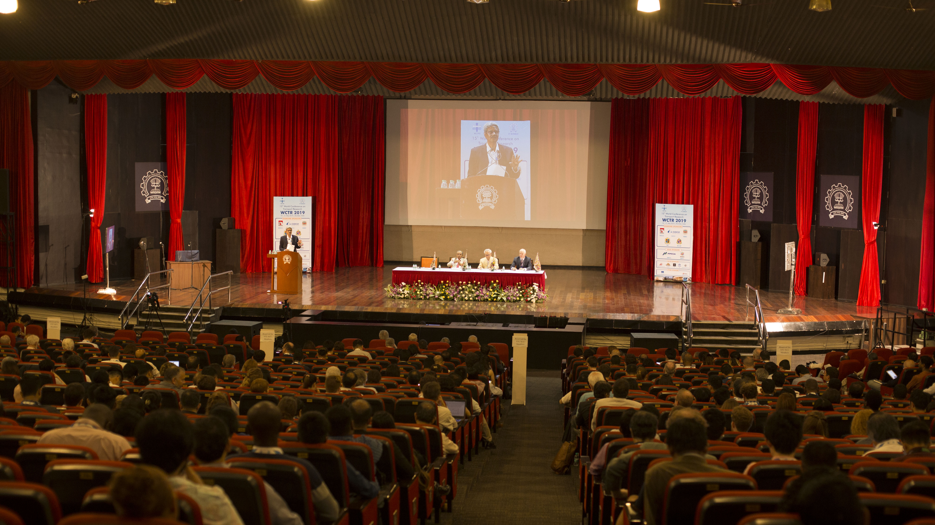

Slide 4
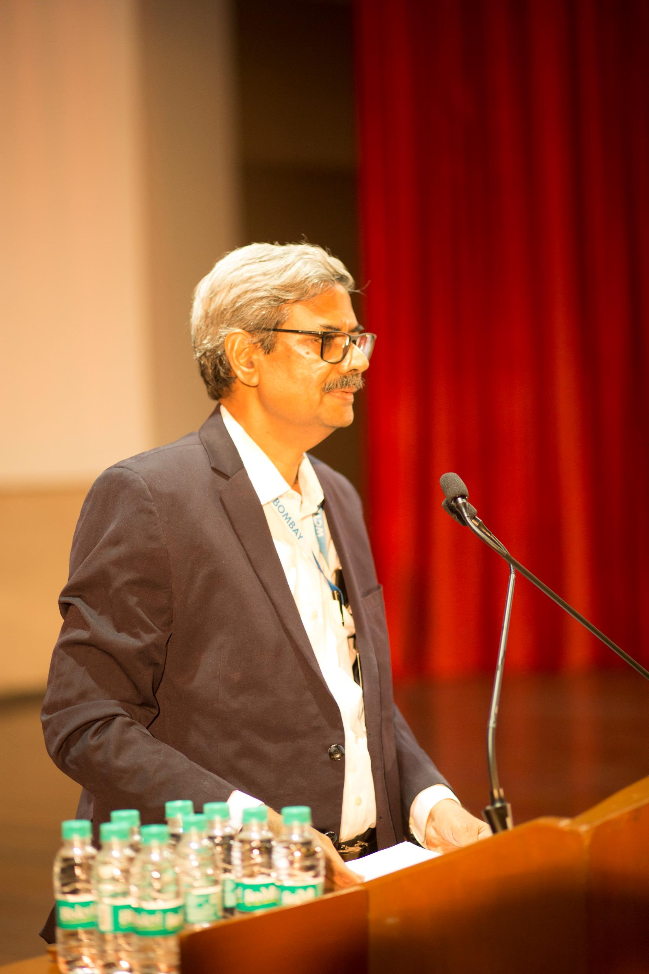
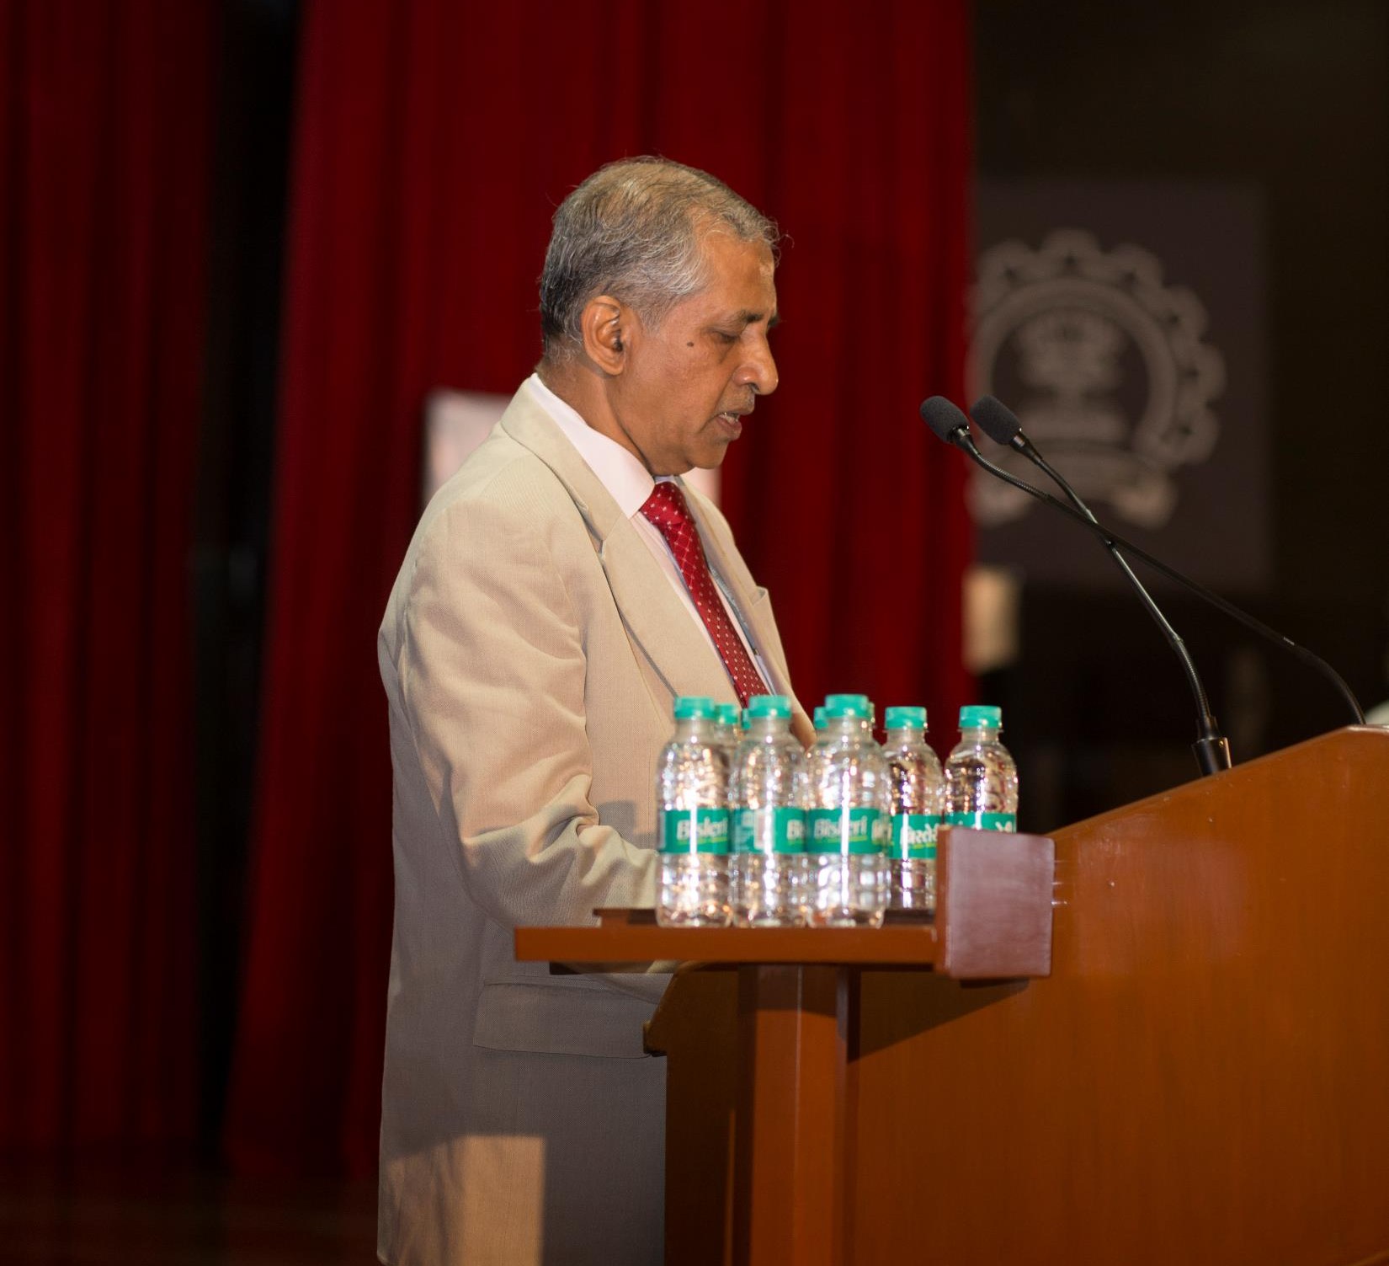
WCTR 2019 Director K V Krishna Rao Speaking at the Opening Ceremony
Deputy Director of IIT Bombay A K Suresh
delivering his welcome address

Slide 5
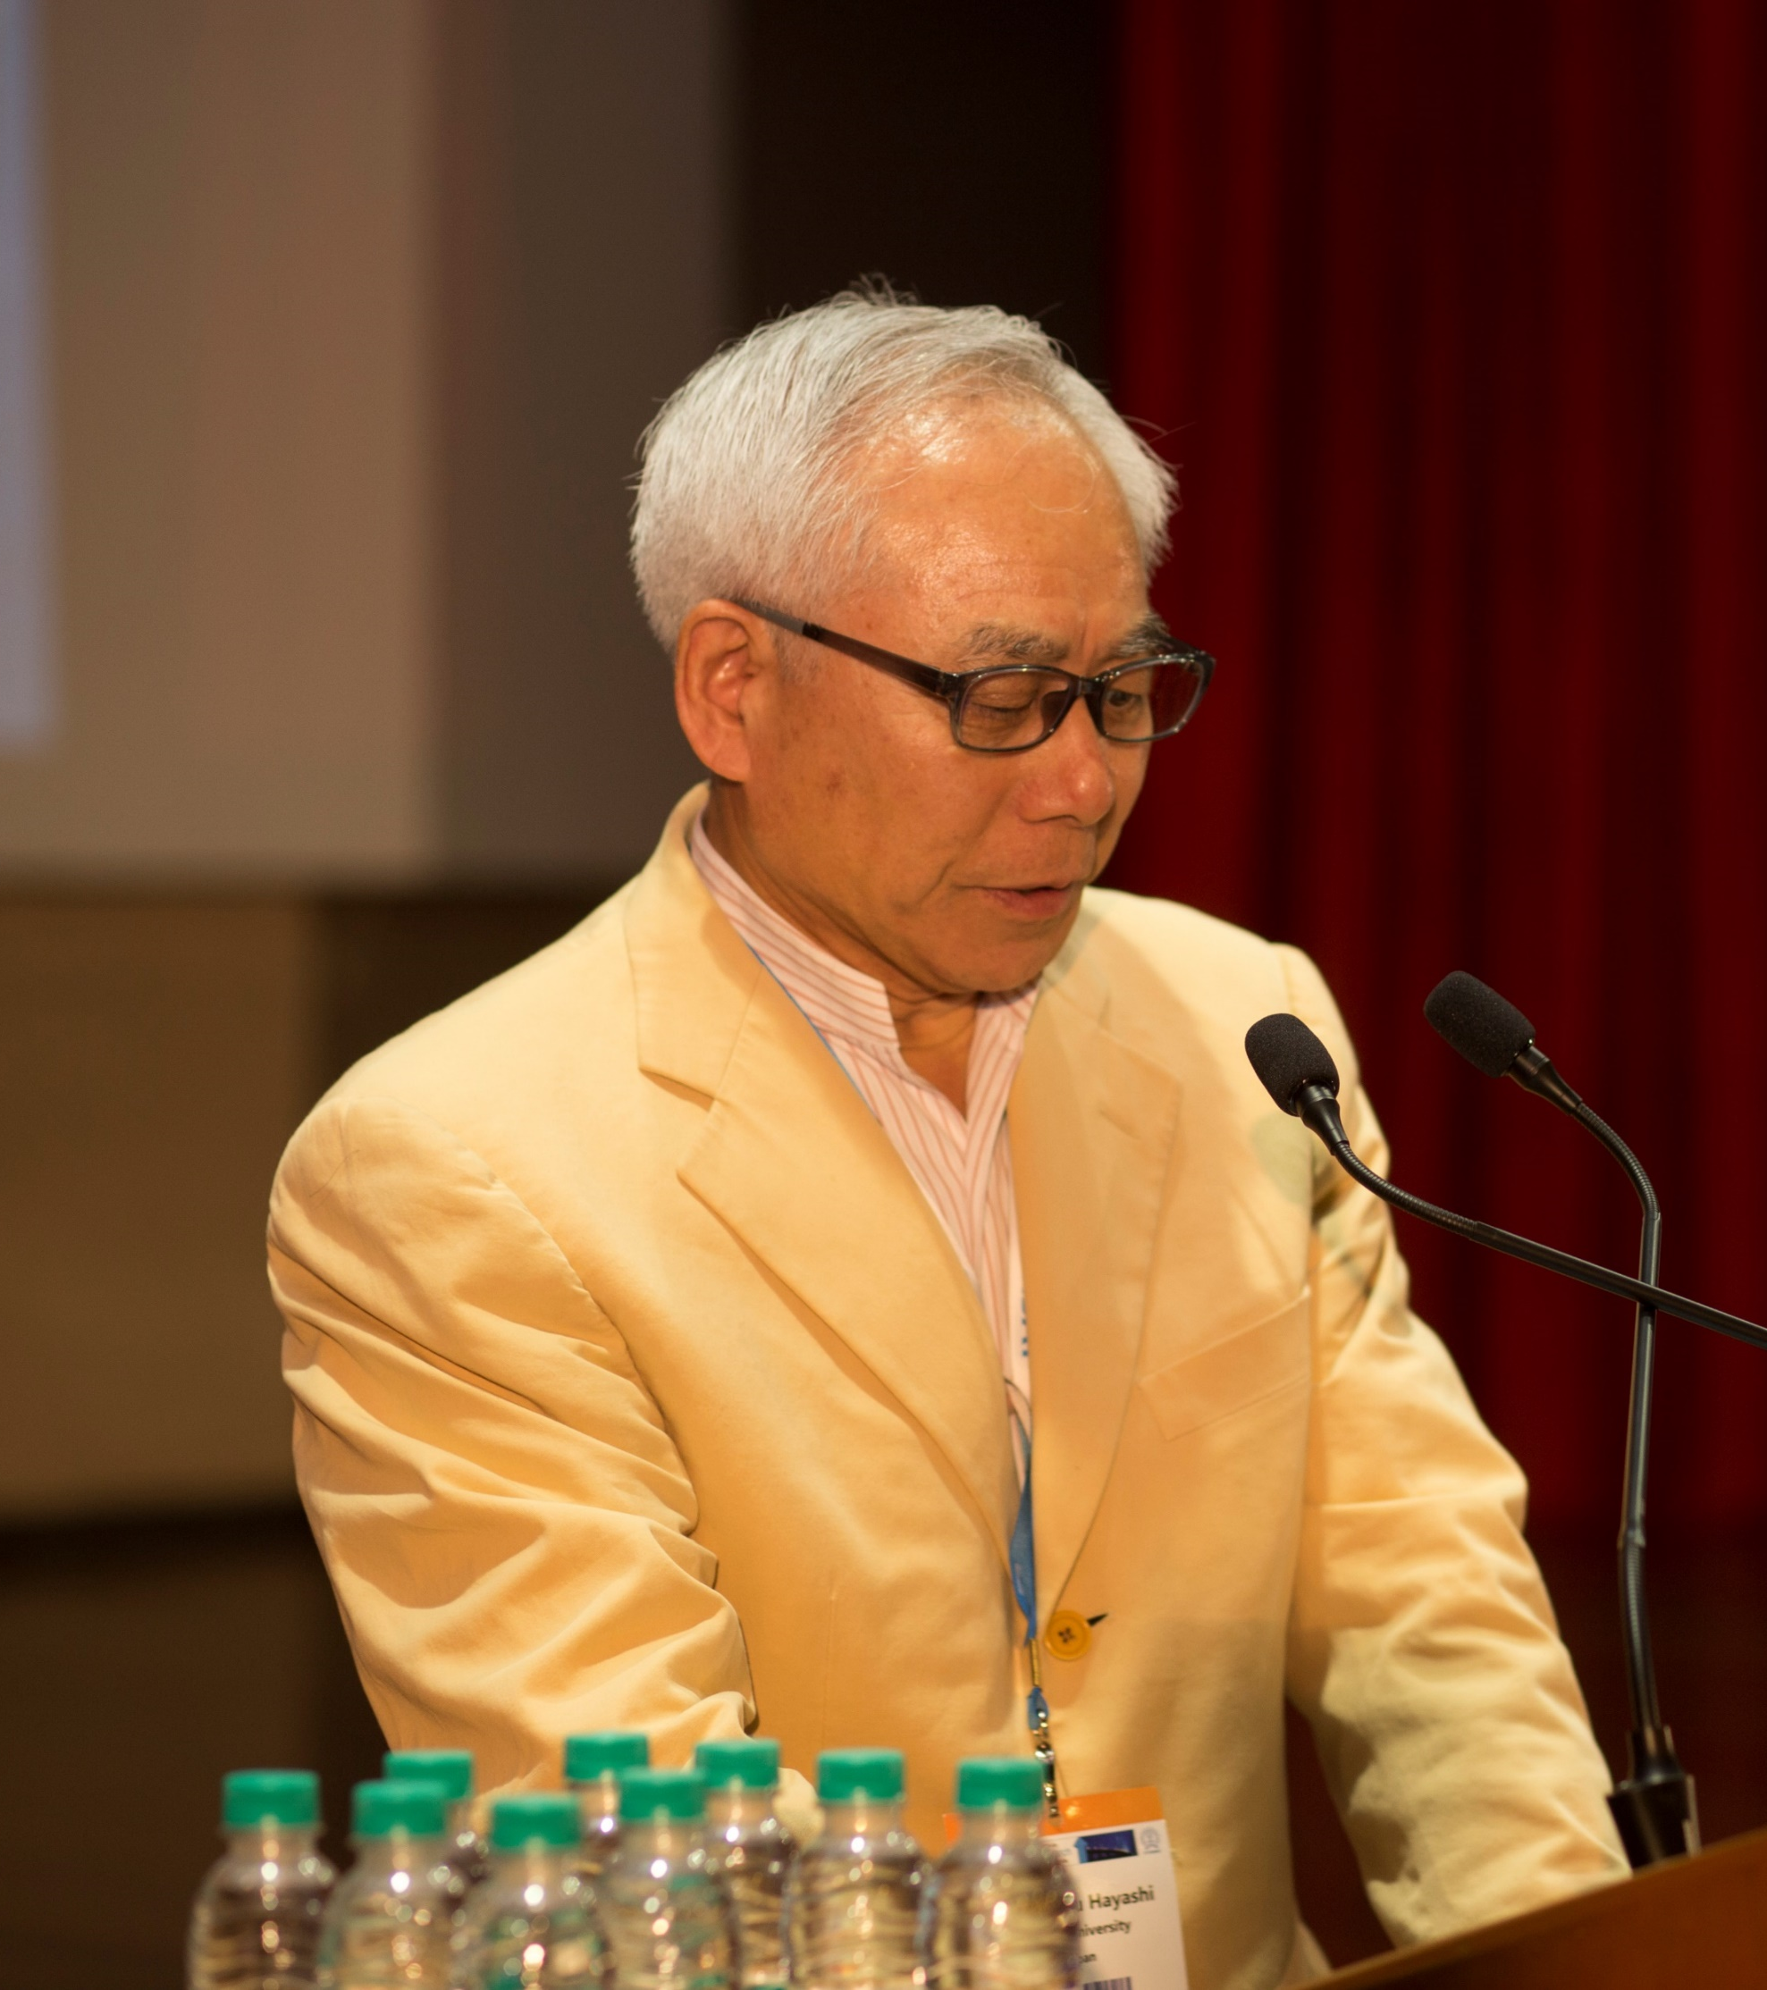
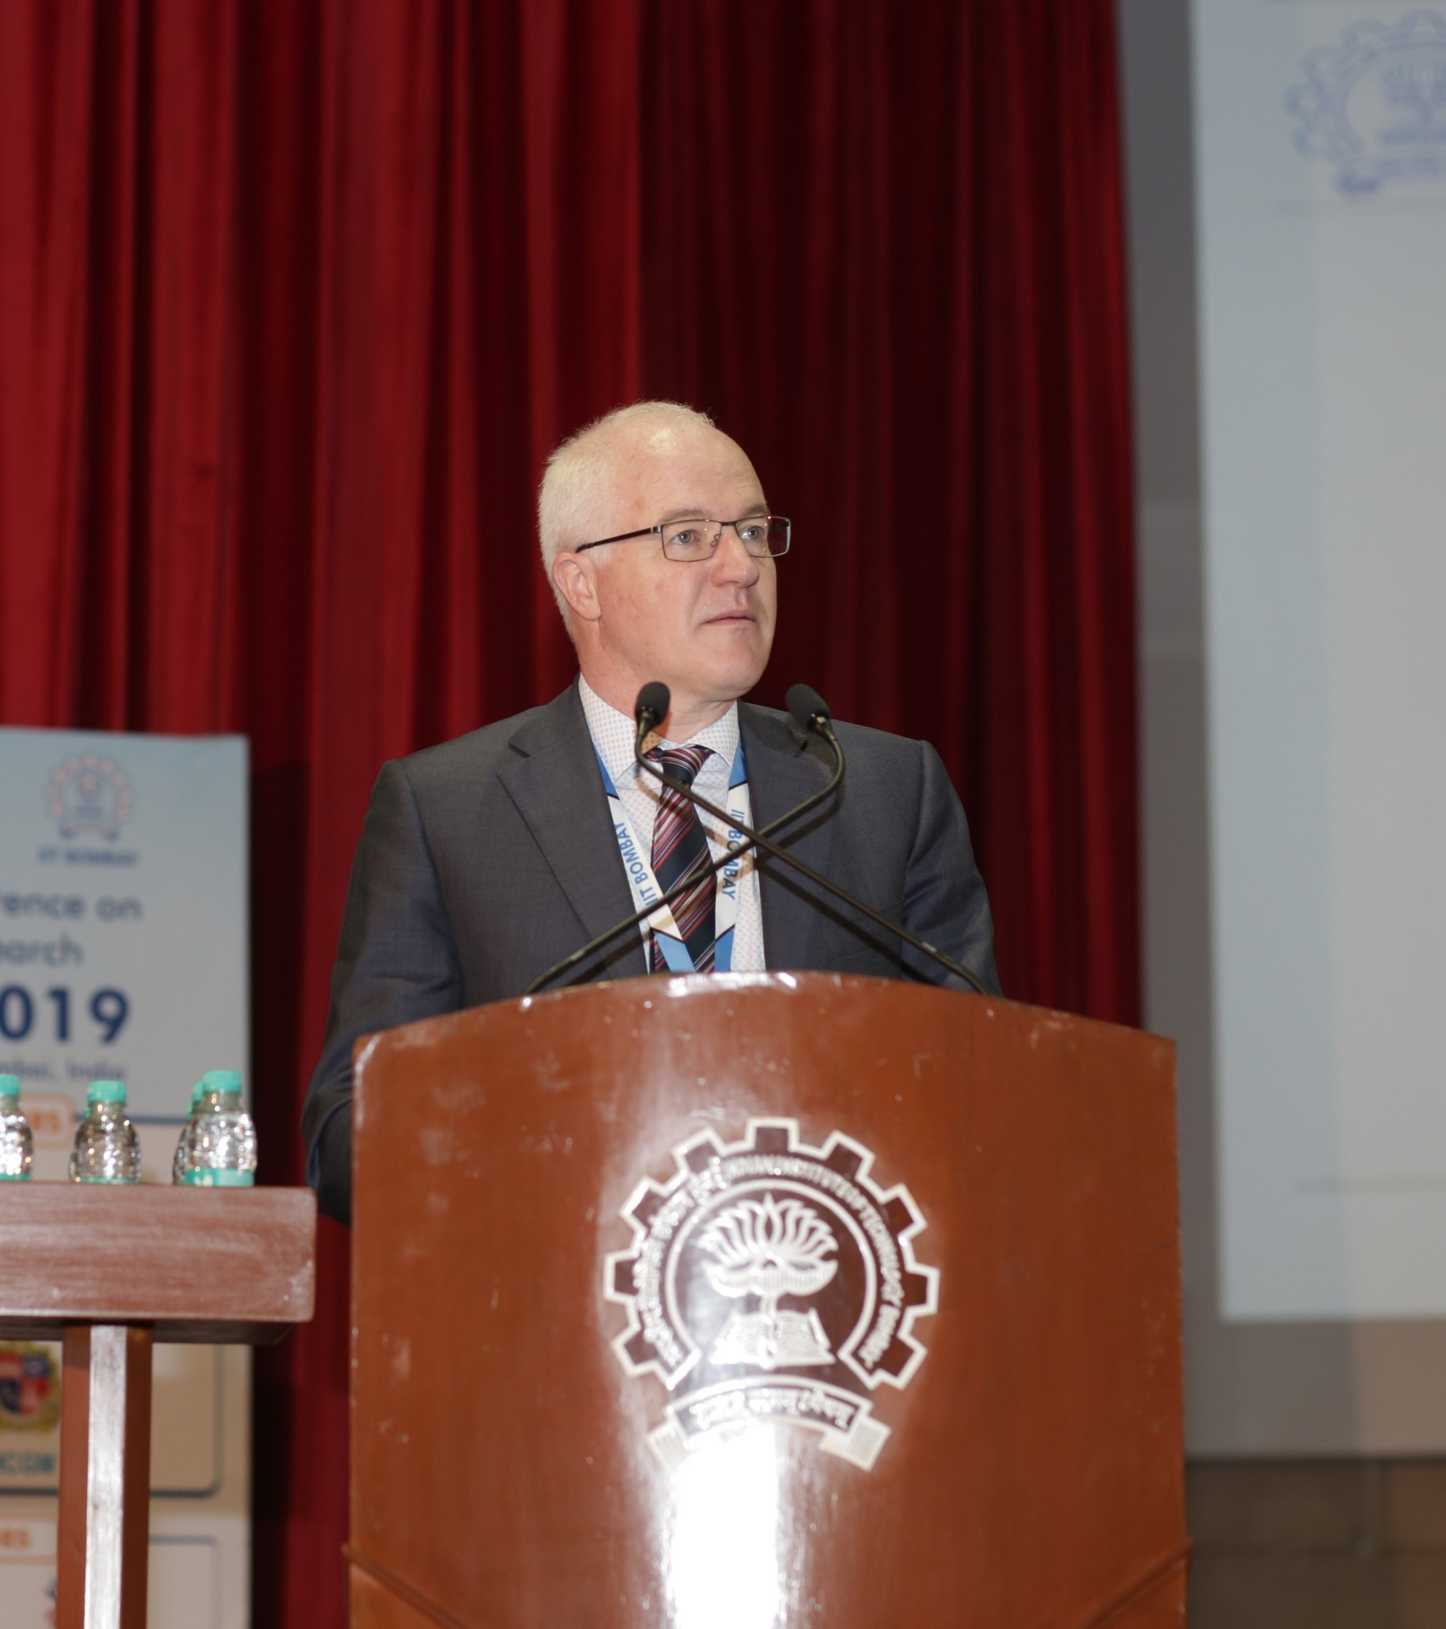
WCTRS President Yoshi Hayashi delivering his opening address
Chair of WCTRS Scientific Committee Lóri Tavasszy introducing the conference programme

Slide 6
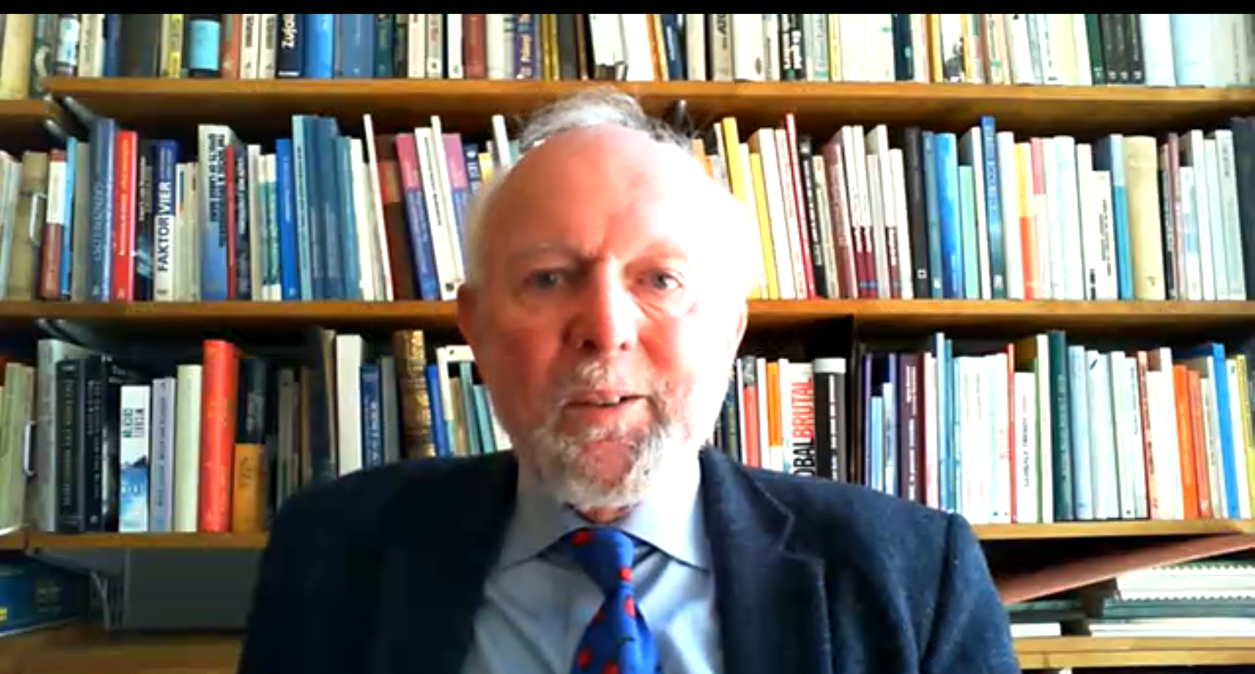
Ernst Ulrich von Weizsäcker, honorary President, The Club of Rome delivering the plenary talk on “Options for reducing the carbon footprint of mobility” at the opening ceremony through videoconferencing

